Slide 1
Transformer Model
Credit to: Prof. Jongwuk Lee, SKKU

Slide 2
References
Online Courses
Natural Language Processing with Deep Learning (Stanford)
Transformer Networks and Convolution Neural Networks
http://web.stanford.edu/class/cs224n/lectures/lecture12.pdf
The Illustrated Transformer
http://jalammar.github.io/illustrated-transformer/
Papers
Ashish Vaswani, Noam Shazeer, Niki Parmar, Jakob Uszkoreit, Llion Jones, Aidan N. Gomez, Łukasz Kaiser, Illia Polosukhin, "Attention Is All You Need," NIPS 2018

Slide 3
Sequence Generator
It would take a sentence in source language, and output its translation in another.
Input
Generator
Output
Thinking machine learning
기계 학습 생각하기

Slide 4
Problems with RNN
Sequential computation prevents parallelization.
Despite GRUs and LSTMs, RNNs still need attention mechanism to deal with long range dependencies.
Can we parallelize the encoding process?
o₁
o₂
o₃
x₁
x₂
…
x_{n}

Slide 5
Problems with RNN
Recap: Attention Module
Still Sequential
o_{t}
h_{t-1}
h_{t}
z
context
Attention Module
Parallel
h₁
h₂
…
h_{n}
Sequential

Slide 6
Problems with RNN
Naïve Attention Module
Hmm.. Not Bad.. but Low Performance!!
o_{t}
h_{t-1}
h_{t}
z
context
Attention Module
Parallel
x₁
x₂
…
x_{n}
No Sequential

Slide 7
Problems with RNN
Another Viewpoint of Naïve Attention Module
o_{t}
Accumulated previous output
h_{t}
z
Attention Module
x₁
x₂
…
x_{n}

Slide 8
Problems with RNN
Another Viewpoint of Naïve Attention Module
o_{t}
Accumulated previous output
Generator Module
x₁
x₂
…
x_{n}

Slide 9
Problems with RNN
Another Viewpoint of Naïve Attention Module
o_{t}
Generator Module
x₁
x₂
…
x_{n}
o₁
o₂
…
o_{t-1}

Slide 10
Problems with RNN
Without Sequential Encoder & Decoder
x₁
x₂
…
x_{n}
o₁
?
Generator
x₁
x₂
…
x_{n}

Slide 11
Problems with RNN
Without Sequential Encoder & Decoder
x₁
x₂
…
x_{n}
o₁
o₂
o₁
?
Generator
x₁
x₂
…
x_{n}
o₁

Slide 12
Problems with RNN
Without Sequential Encoder & Decoder
x₁
x₂
…
x_{n}
o₁
o₂
o₃
o₁
o₂
?
Generator
x₁
x₂
…
x_{n}
o₁
o₂

Slide 13
Problems with RNN
Sequential computation prevents parallelization.
o₁
O₂
O_{t}
??
Generator
Encoder
Encoder
x₁
x₂
…
x_{n}
o₁
o₂
…
o_{t}

Slide 14
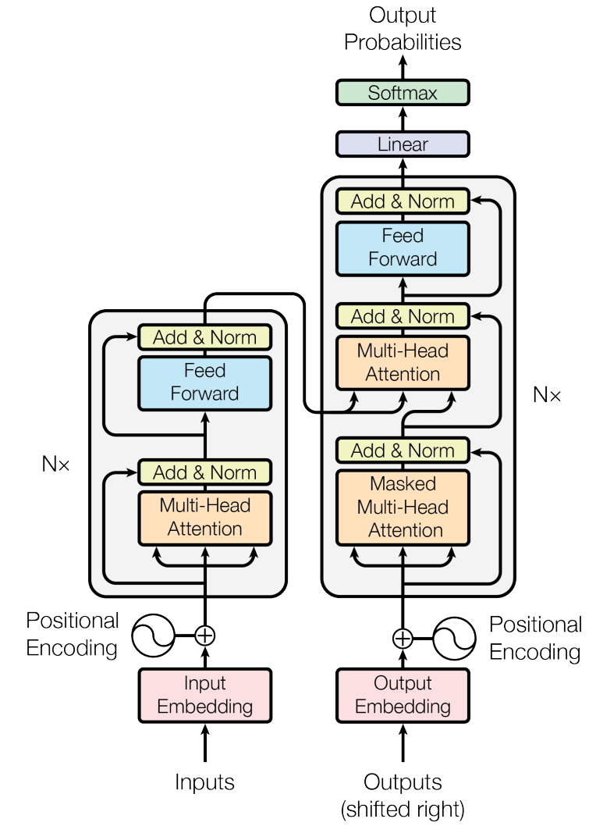
Transformer Overview
Encoder-Decoder approach
Task: machine translation with parallel corpus
Predict each translated word.
Final cost/error function is standard cross-entropy error on top of a softmax classifier.

Slide 15
Encoder

Slide 16
Encoder Internals
After embedding the words in the input sentence, each of them flows through the two layers of the encoder.
Feed forward
Feed forward
Feed forward
Self-Attention
Thinking
machine
learning

Slide 17
Recap: Attention Mechanism
Dot Product Attention
o_{t}
Weighted summation
of each input considering context
h_{t-1}
h_{t}
z
+
X
X
X
context
s₁
s₂
s_{n}
(query)
Softmax
m₁
m₂
m_{n}
Dot Product
Dot Product
Dot Product
value
x₁
x₂
…
x_{n}
key

Slide 18

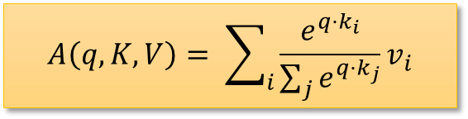






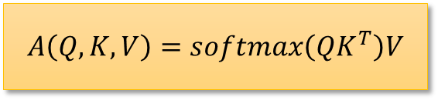

Recap: Attention Mechanism
Using multiple queries, we stack them into a matrix $Q$.
It becomes
$$A\left(q, K, V\right)= \sum_{i}{\frac{e^{q⋅k_{i}}}{\sum_{j}{e^{q⋅k_{j}}}}}v_{i}$$
$$A\left(Q, K, V\right)=softmax\left(QK^{T}\right)V$$
$$($$
$$)$$
$$softmax$$
$$=|Q|×k$$
$$\left|Q\right|×k$$
$$|V|×k$$
$$k×\left|K\right|$$

Slide 19




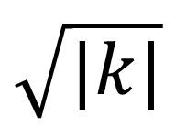

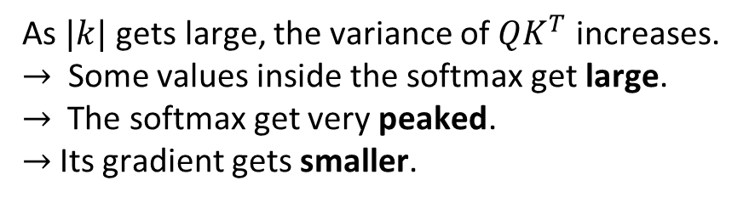
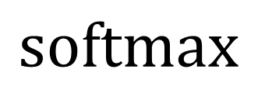



Recap: Attention Mechanism
$$Q$$
$$K^{T}$$
$$⋅$$
$$V$$
$$($$
$$)$$
$$softmax$$
$$⋅$$
$$\sqrt{|k|}$$
$$=$$
As $|k|$ gets large, the variance of $QK^{T}$ increases.
$→$ Some values inside the softmax get large.
$→$ The softmax get very peaked.
$→$Its gradient gets smaller.

Slide 20



Self-Attention
$$A\left(x_{i}, X, X\right)$$
Definition:
$$s_{i1}x_{1}+s_{i2}x_{2}+…+s_{in}x_{n}$$
+
X
X
X
s_{i1}
s_{i2}
s_{in}
Softmax
m_{i1}
m_{i2}
m_{in}
Dot Product
Dot Product
Dot Product
$$x_{i}$$
value
x₁
x₂
…
x_{n}
key
$$A\left(x_{i}, X,X\right)=s_{i1}x_{1}+s_{i2}x_{2}+…+s_{in}x_{n}=x_{i}′$$

Slide 21
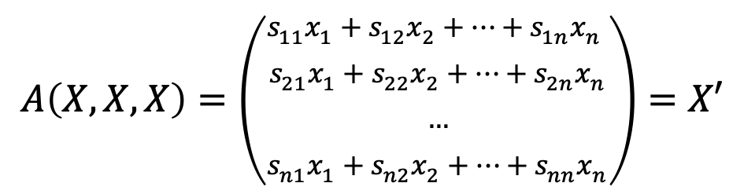
Self-Attention
Definition:
$$A\left(X, X, X\right)=\left(\begin{aligned}s_{11}x_{1}+s_{12}x_{2}+…+s_{1n}x_{n} \\ s_{21}x_{1}+s_{22}x_{2}+…+s_{2n}x_{n} \\ … \\ s_{n1}x_{1}+s_{n2}x_{2}+…+s_{nn}x_{n}\end{aligned}\right)=X′$$

Slide 22
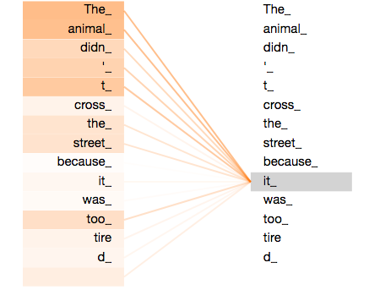
Self-Attention
Learning long-range dependencies in the network
Effective for parallelization for efficient computation
The animal didn't cross the street because it was too tired
When the model is processing the word “it”, self-attention allows it to associate “it” with “animal”.

Slide 23

Multi-headed Attention
Refine the self-attention layer by adding a mechanism called “multi-headed” attention.
It expands the model’s ability to focus on different positions.
It gives the attention layer multiple representation subspaces.

Slide 24
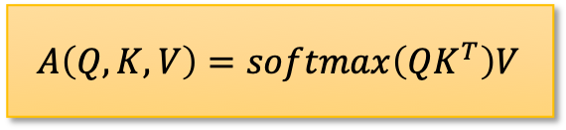

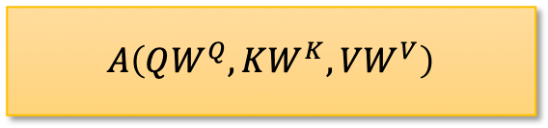
Multi-headed Attention
Attention
$$Q:\left|Q\right|×k, K:\left|K\right|×k, V:\left|V\right|×k$$
What is ‘headed’?
Linear Transformed: $W^{Q}, W^{K}, W^{V} \left(=k×m\right)$
$$A\left(Q, K, V\right)=softmax\left(QK^{T}\right)V$$
$$A\left(QW^{Q}, KW^{K}, VW^{V}\right)$$

Slide 25









Multi-headed Attention
Head: A viewpoint of similarity
$$A\left(QW^{Q}, KW^{K}, VW^{V}\right)$$
$$k$$
$$m$$
$$Q$$
$$QW^{Q}$$
Attention
$$K$$
$$KW^{K}$$
$$V$$
$$VW^{V}$$

Slide 26
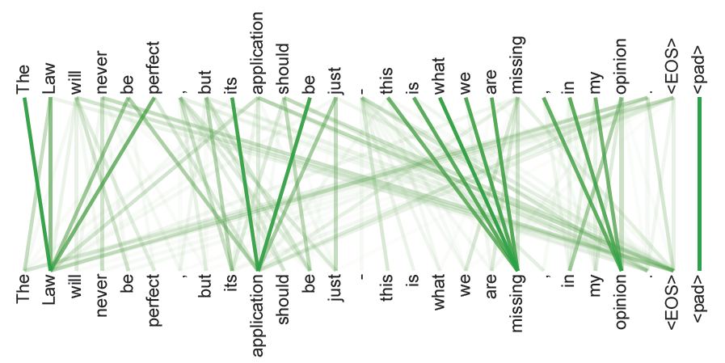
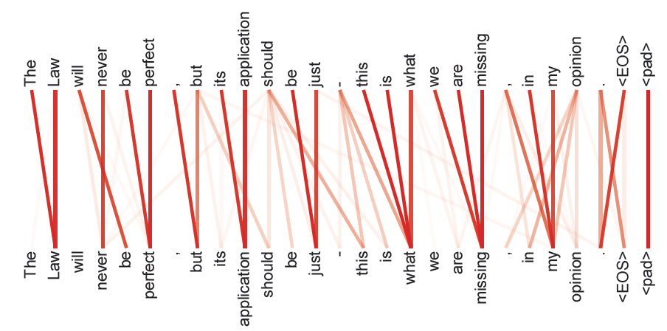
Multi-headed Attention
Head: A viewpoint of similarity
The encoder self-attention at layer 5 and 6.
The heads clearly learned to perform different tasks.

Slide 27











Multi-headed Attention
Let’s use multiple heads to capture various similiarities
$$m$$
$$k$$
$$Z_{1}Z_{2}…Z_{n}$$
$$A\left(QW_{1}^{Q}, KW_{1}^{K}, VW_{1}^{V}\right)=Z_{1}$$
$$…$$
$$×$$
$$A\left(QW_{2}^{Q}, KW_{2}^{K}, VW_{2}^{V}\right)=Z_{2}$$
$$k$$
$$…$$
$$…$$
$$A\left(QW_{n}^{Q}, KW_{n}^{K}, VW_{n}^{V}\right)=Z_{n}$$
$$=$$

Slide 28



Multi-headed Attention
Let’s use multiple heads to capture various similiarities
$$Q$$
Attention
$$K$$
Multi-Head
Attention
$$V$$

Slide 29
Feed Forward
Point-wise Feed Forward
Feed forward
Feed forward
Feed forward
Multi-Head Attention
Embedding
Input
Thinking
machine
learning

Slide 30
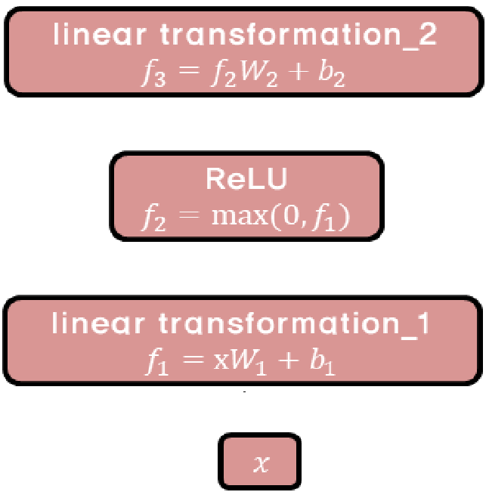
Feed Forward
Point-wise Feed Forward

Slide 31





Positional Encoding
Need to consider the order of the words in the input sentence.
Encoder #1
Encoder #0
Embedding with time signal
$$=$$
$$=$$
$$=$$
Positional encoding
$$+$$
$$+$$
$$+$$
Embedding
Input
Thinking
machine
learning

Slide 32
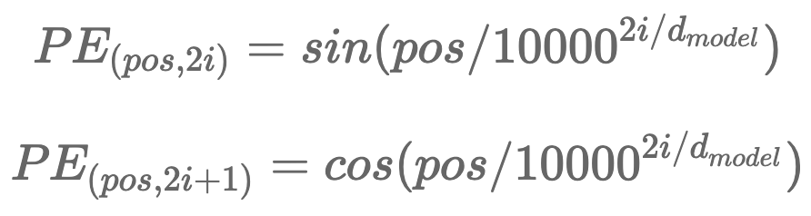






Positional Encoding
Assume that embedding has a dimensionality of 4.
The positional embedding would look like this:
Use cosine and sine curves.
$$<0, 0, 1, 1>$$
$$<0.84, 0.01, 0.54, 1>$$
$$<0.91, 0.01, −0.42, 1>$$
Positional encoding
$$+$$
$$+$$
$$+$$
Embedding
Input
Thinking
machine
learning

Slide 33
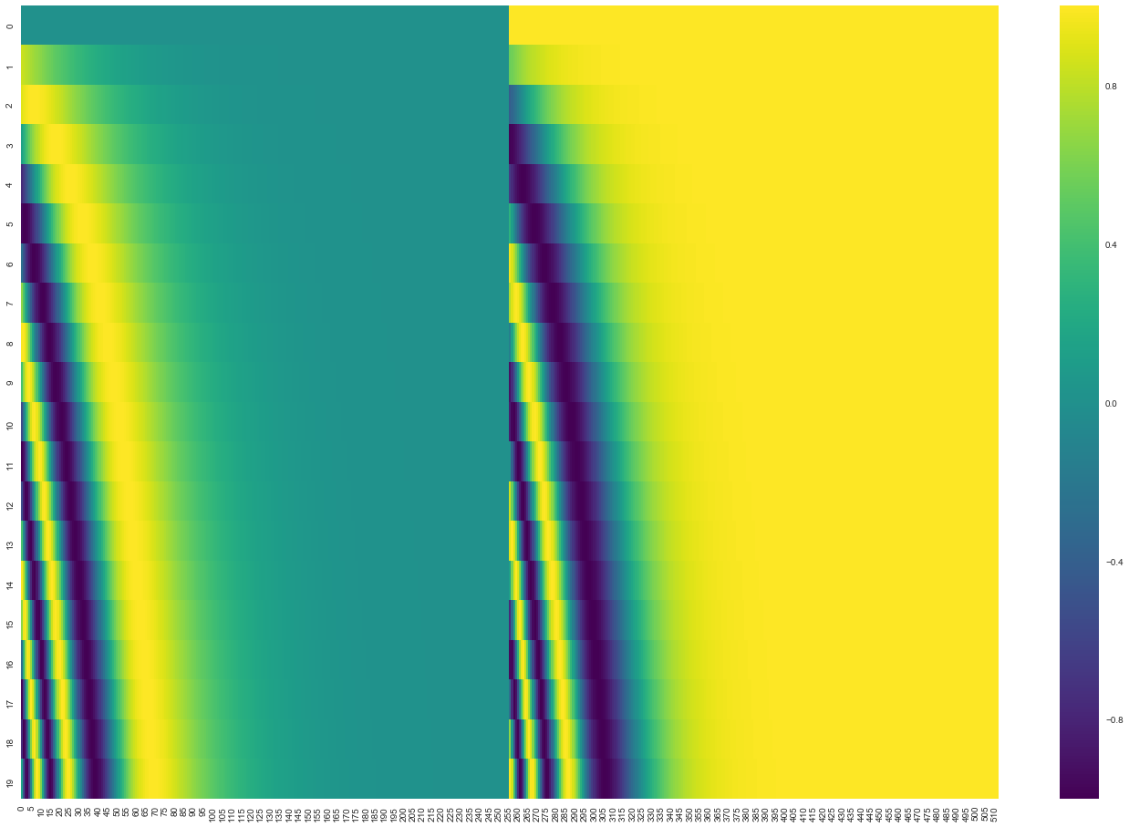
Positional Encoding
Each row corresponds to the a positional encoding of size 512.

Slide 34
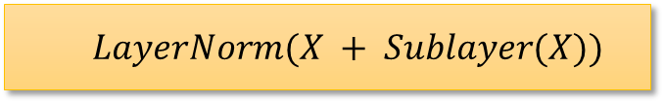
Complete Transformer Block
Each block has two sublayers.
Multi-head attention
2 layer feed-forward net (with relu)
Each of these two steps also has:
Residual (short-circuit) connection and LayerNorm:
Layer normalization
https://arxiv.org/pdf/1607.06450.pdf
$$LayerNorm(X + Sublayer(X))$$

Slide 35
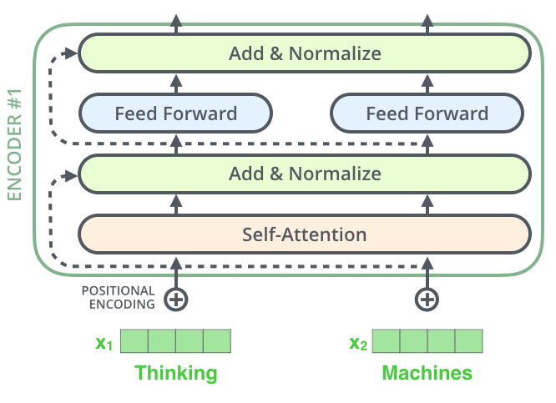
Residual Connection
Each sublayer in each encoder has a residual connection.

Slide 36
Simplified Transformer
Q: 재해석된
재해석된 O
K: 재해석된 X
V: 재해석된 X
출력과 입력을 섞어가면서 계속 가공해간다.

Slide 37
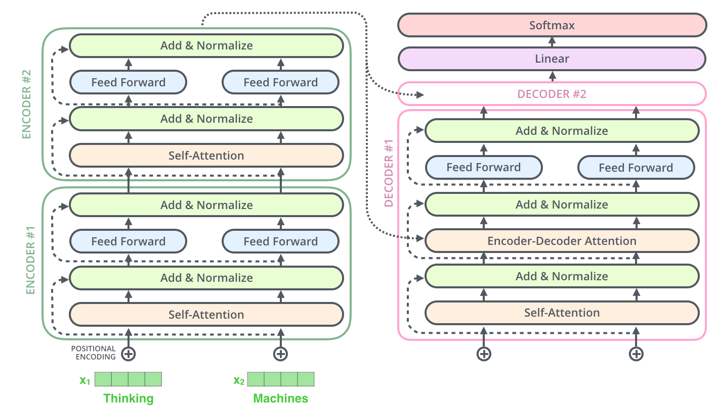
Simplified Transformer
It consists of 2 stacked encoders and decoders.

Slide 38
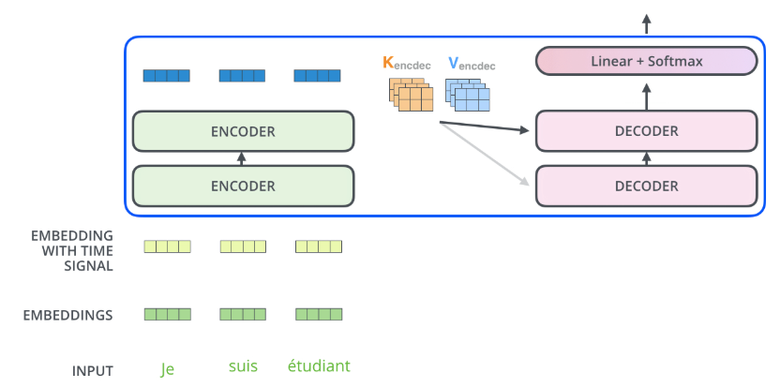

Decoder: Encoder-Decoder Attention
The output of the top encoder is then transformed into a set of attention vectors $K$ and $V$.
These are to be used by each encoder in its “encoder-decoder attention” layer.
Next word prediction

Slide 39
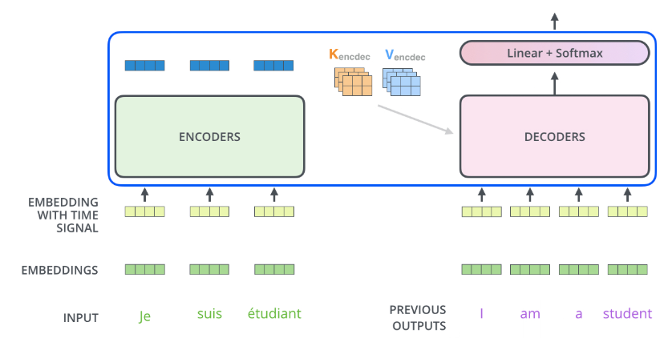
Decoder: Encoder-Decoder Attention
The self-attention layer in the decoder is only allowed to attend to earlier positions in the output sequence.
Next word prediction

Slide 40

Decoder: Encoder-Decoder Attention
2 sublayer changes in decoder.
Masked decoder
Self-attention on previously generated outputs is only used.
Encoder-decoder attention
Queries come from previous decoder layer and keys and values come from output of encoder.

Slide 41
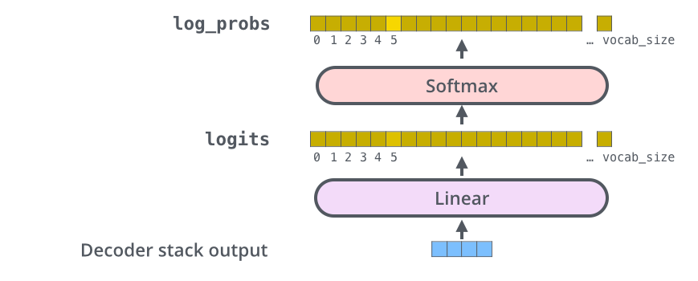
Final Linear and Softmax Layer
The Linear layer is a simple fully connected neural network that projects the vector produced by the stack of decoders, into a much, much larger vector called a logits vector.
The softmax layer then turns those scores into probabilities (all positive, all add up to 1.0).

Slide 42
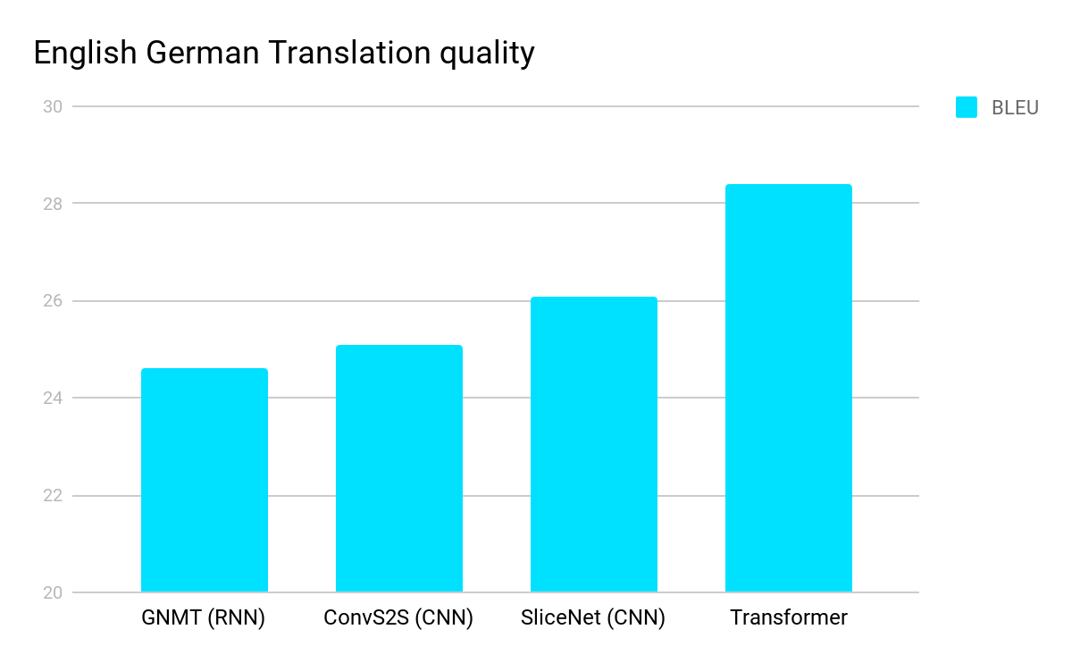
Experimental Results
https://ai.googleblog.com/2017/08/transformer-novel-neural-network.html

Slide 43
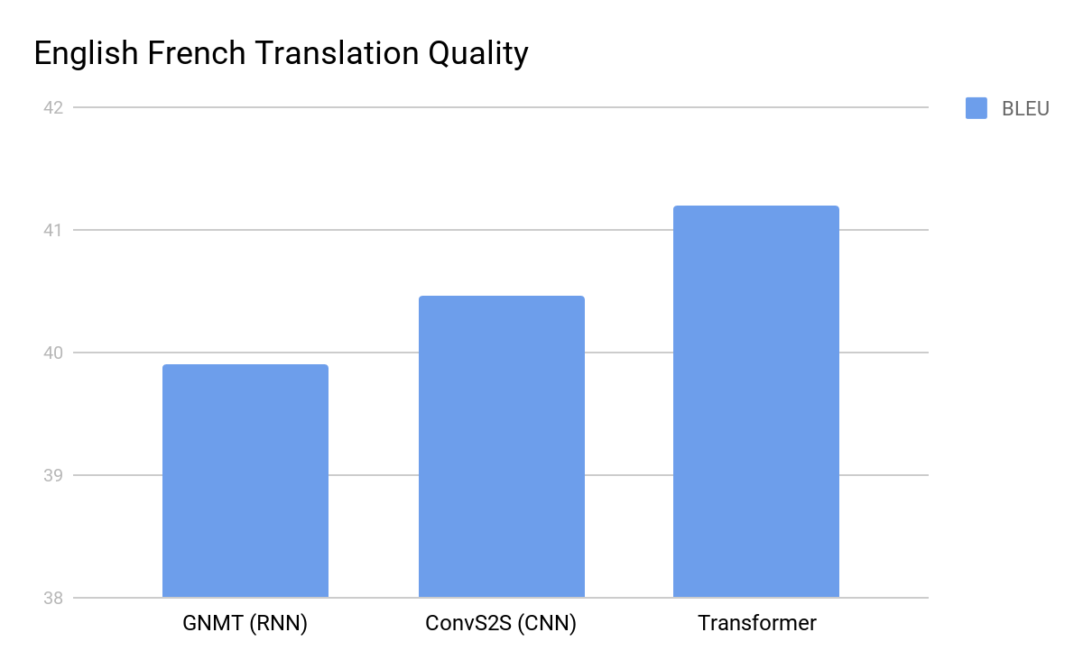
Experimental Results
https://ai.googleblog.com/2017/08/transformer-novel-neural-network.html

Slide 44
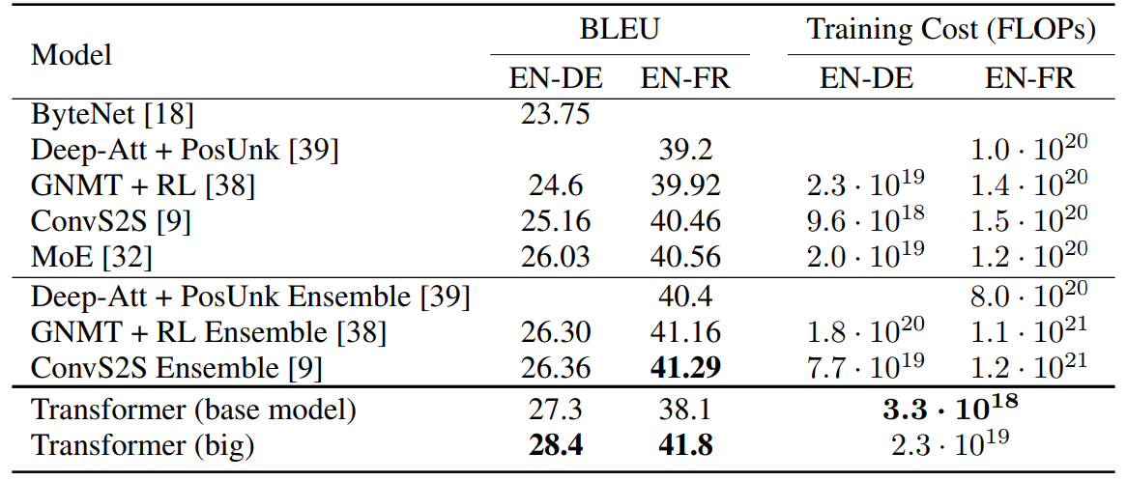
Experimental Results
The Transformer achieves better BLEU scores than the previous model, and training cost is much smaller.

Slide 45

Q&A

